Slide 1
Exploratory Data Analysis and Visualization of New York City Airbnb Listings – 02/17/21
Kapil Pundhir, Hillary Mandich, Cecilia Leung, Amaris Hassan, Caitlan Beachey

Slide 2


Introduction
Airbnb has over 7 million listings and over 2.9 million hosts worldwide.
Airbnb is available in over 100, 000 cities, but the United States alone holds the highest number of listings of any country in the world.
New York City (NYC) is one of the most visited tourist attractions globally, a major center of the entertainment industry, and the world’s leading financial center.
With these factors in consideration, it comes as no surprise that NYC is also one of the top three most popular cities used on Airbnb.
Notes:
In-depth analysis on one of the most densely populated cities in the world.

Slide 3
Exploratory Questions
What are the different types of properties in NYC?
Does property type availability vary by neighbourhood?
What neighbourhoods in NYC are rated highly by guests?
How do prices of listings vary by location?
How has the demand for Airbnb rentals evolved over time?
Notes:
The aim of our project’s analysis is to answer the following questions:
What are the different types of properties in NYC?
Does property type availability vary by neighbourhood?
What neighbourhoods in NYC are rated highly by guests?
How do prices of listings vary by location?
How has the demand for Airbnb rentals evolved from ** date?

Slide 4
Analysis of Data Quality
Data Sourced from Inside Airbnb (http://insideairbnb.com/get-the-data.html ) which hosts publicly available data from the Airbnb site.
Detailed listings data provided 36924 records for NYC.
Data comprised of 64 attributes covering listing amenities, listing availability, neighbourhood, host background, and reviews for each record.
Notes:
-The data is sourced from the Inside Airbnb website http://insideairbnb.com/get-the-data.html which hosts publicly available data from the Airbnb site.
-Columns/features we were interested in did not contain data in the required format and hence were manipulated in a way that their meanings are retained.

Slide 5
Analysis of Data Quality
price : Column contained data in string format with the currency symbol ‘$’ and comma separator
host_response_time and host_response_rate : Columns contained data in string format with the percent symbol ’%’
host_is_superhost, host_identity_verified, has_availability, instant_bookable : Columns contained data ”t” and “f” in string format instead of Boolean.
Redundancy for listings availability data:
availability_30, availability_60, availability_90, availability_365, minimum_minimum_nights,
maximum_minimum_nights, minimum_maximum_nights, maximum_maximum_nights,
minimum_nights_avg, minimum_nights_avg_ntm, maximum_nights_avg_ntm
Notes:
Some columns containing attributes we were interested did not contain data in the required format. Needed to be manipulated in a way that their meanings were retained.

Slide 6
Data Munging Techniques
Notes:
-The data is sourced from the Inside Airbnb website http://insideairbnb.com/get-the-data.html which hosts publicly available data from the Airbnb site.
-Columns/features we were interested in did not contain data in the required format and hence were manipulated in a way that their meanings are retained.
(Give brief overview of columns/rows we began with → Final result of Listings Cleaned
Values in columns comprised of special characters (e.g. $, %, and ,) were standardized.
Needed to further reduce the size of dataset to meet free uploading requirements to postgres SQL.

Slide 7
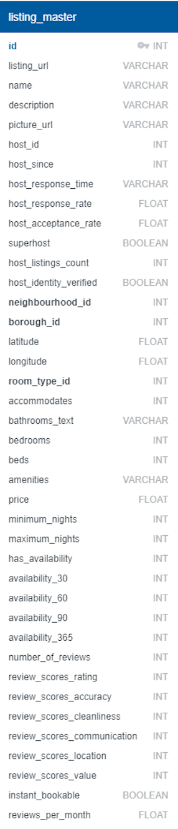
Final Dataset
Notes:
-(Give brief overview of columns/rows we began with → Final result of Listings Cleaned
*Include screenshot of dashboard summary.

Slide 8
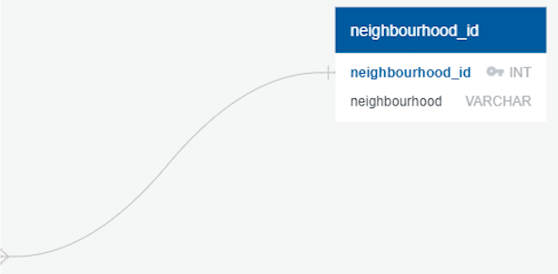

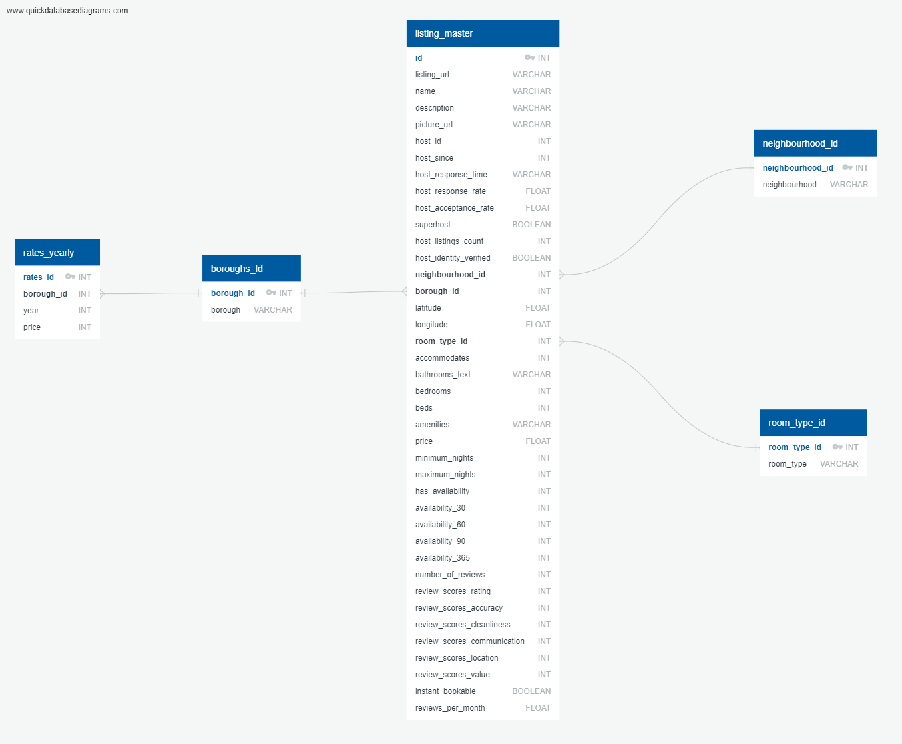
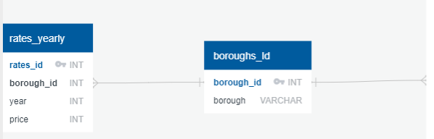
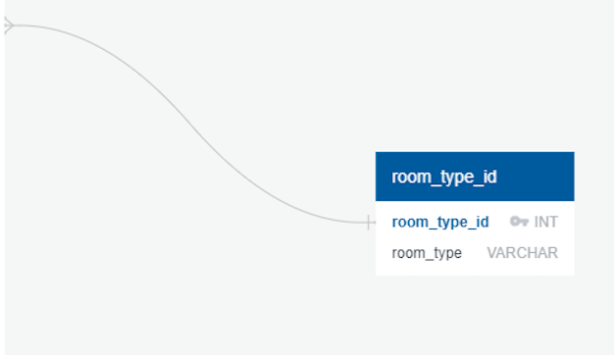
Relationship of Datasets
Notes:
*** Include screen shot of ERD Diagram
*** Provide details on Elephant SQL screenshots/ queries.
*Uploaded tables using Jupiter Notebook and Pandas
*Challenges:
* Had to create a new database and flask database
*Elephant SQL – Original data set was too large when we tried to load
*Used Elephant SQL to connect to postgres SQL
(Kapil and Hilary)

Slide 9
Property types available in NYC
Notes:
Include screenshot of interactive map.
Zoom into features of Map over a few slides!

Slide 10
Property types available in NYC
Notes:
Include screenshot of interactive map.
Zoom into features of Map over a few slides!

Slide 11
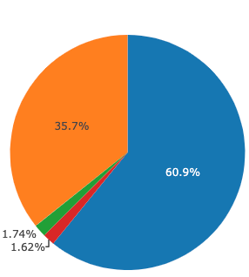
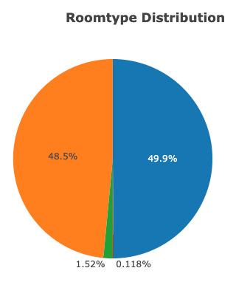
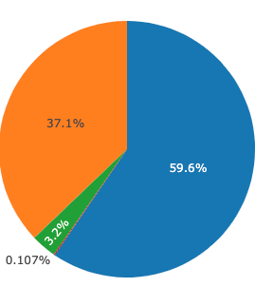
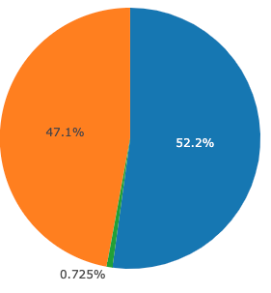
Property types available in NYC
Manhattan
Brooklyn
Bronx
Queens
Staten Island
Notes:
Manhattan
Brooklyn
Bronx
Queens
Staten Island

Slide 12
NYC Neighbourhood Ratings
Notes:
Include Image of Top 15 Neighbourhoods***

Slide 13
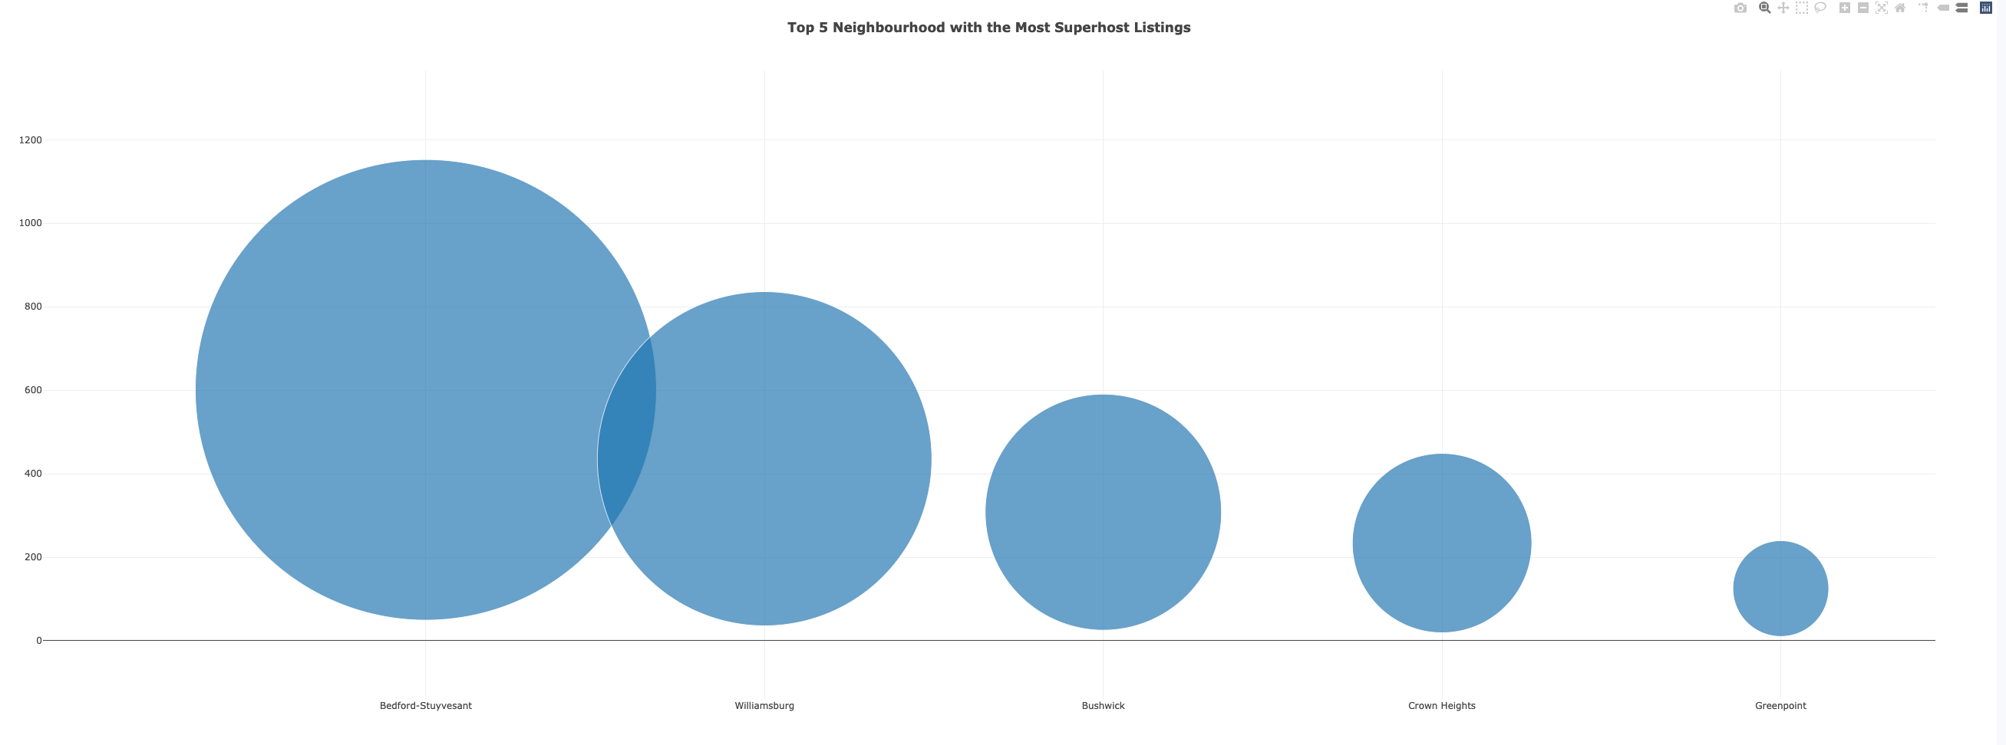
NYC Neighbourhood Ratings
Notes:
Superhost Requirements:
- Completed at least 10 trips OR completed 3 reservations that total at least 100 nights
Maintained a 90% response rate or higher
Maintained a 1% percent cancellation rate (1 cancellation per 100 reservations) or lower
Maintained a 4.8 overall rating (this rating looks at the past 365 days of reviews, based on the date the guest left a review, not the date the guest checked out)
Provide top neighbourhood per borough
Manhattan -
Brooklyn -
Bronx -
Queens -
Staten Island -

Slide 14
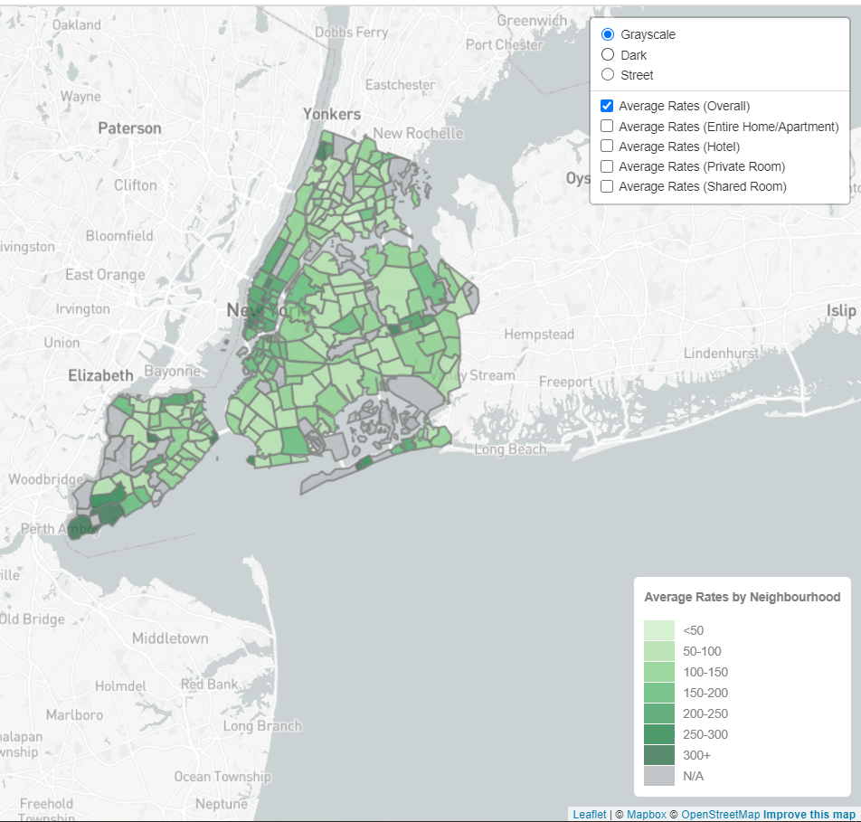
Pricing of NYC Neighbourhoods
Notes:
How do prices of listings vary by location?
Most expensive neighbourhood:
Most affordable neighbourhood:

Slide 15
Dashboard Design
Notes:
***Create summary of new Javascript Library/difficulties
***Any html/bootstrap features

Slide 16
Dashboard Design

Slide 17
Project Takeaways

Slide 18
Next Steps…
A major area of concern for cities worldwide is the effect that expansion of Airbnb has made on the housing market for indigenous residents.
Further analysis can help determine if there is a correlation between Airbnb listings and rental/house prices for NYC neighbourhoods.
- Create a model to predict the average Airbnb prices in New York.

Slide 19
Thank You!

Slide 20
Q&A…

